Slide 1
TTCN-3 embedded
the conceptual extension of TTCN-3 for testing continuous and hybrid systems
Jürgen Großmann (Fraunhofer FOKUS), Hans-Werner Wiesbrock (IT Power Conultants), Friedrich-Wilhelm Schröer (Fraunhofer FIRST) and Jacob Wieland (Testing Technologies)
TTCN-3 User Conference 2011
7 – 9 June 2011 - Bled, Slovenia

Slide 2
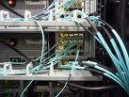
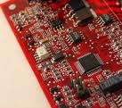
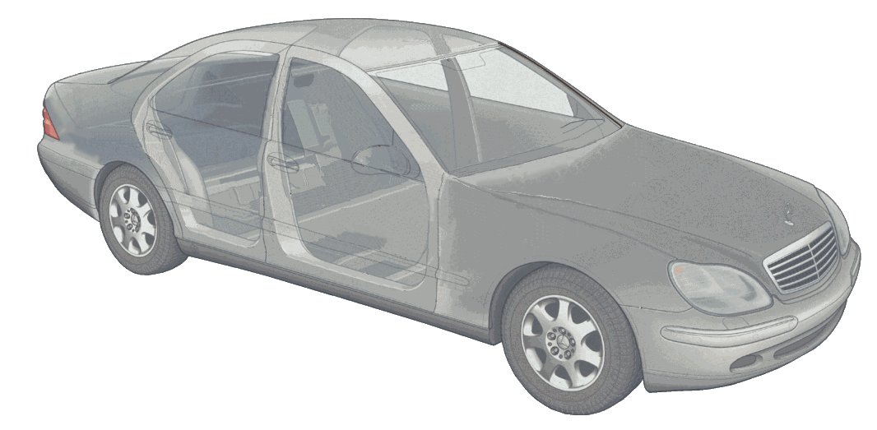
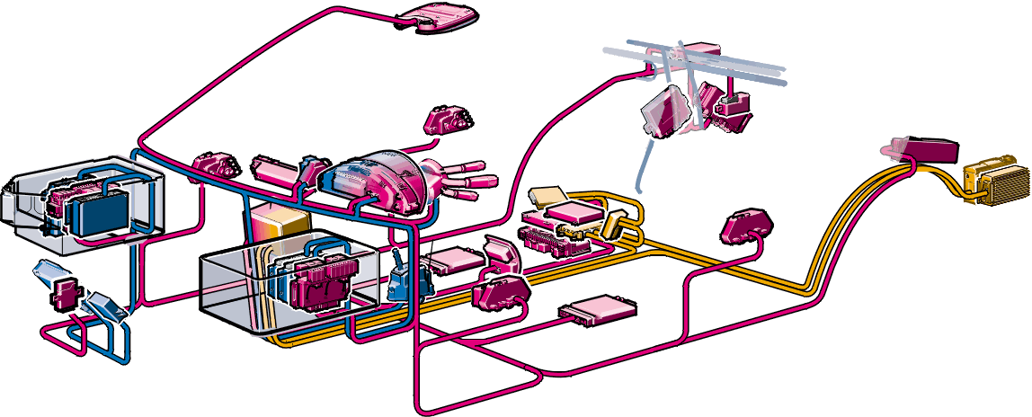
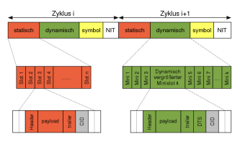
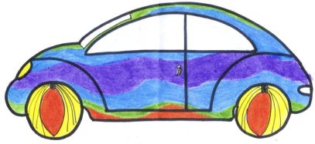
Embedded Systems Become communicating systems
ITS G5
IVS
IVS
802.11 b/g and ITS G5
IRS
IRS
IRS

Slide 3
Motivation Why TTCN-3 embedded
TTCN-3: Mature, industry grade standard
TTCN-3: Provides a clear and well defined test system architecture
TTCN-3: Provides powerful language constructs for automation and reusability
TTCN-3 embedded provides additional concepts for testing hybrid systems
flexible time concepts (real time and simulation time)
control flow structures to model signal changes over time
efficient access to individual signal values

Slide 4
Results of TEMEA TTCN-3 embedded
RT TTCN-3 Concepts (status: integrated in TTCN-3 extensions: TTCN-3 Performance and Real Time Testing)
clock as a common basis for time measurement.
timestamp redirection for exact time measurement of message interaction.
Continuous TTCN-3 Concepts (status: change request)
sampled clock as a common basis for discretization and stream definitions.
sampled streams that provide a data structure to define, access and manipulate discretized signal values and their history in time.
hybrid automatons, that provides a control flow structure to enable and control the simultaneous stimulation and evaluation of stream ports.
RT-TTCN-3 Concepts
Continuous TTCN-3 Concepts
TTCN-3 Core Standard
Notes:
Intention:
Provide an overview over the basic means of Continuous TTCN-3
Additional Explanation:
Stream:
A stream is a ow of data over time, which has a data
value being dened for every point in time the stream
elements. We dene streams relative to a sample that repre-
sents global time. In contrast to scalar values, a stream [2,9] represents the whole allocation history
applied to a port. In CTTCN-3 the term stream is used to denote the data
structure that describes the complete history of data that yield
as allocation of a certain port xn; ym.
As scalar types, all TTCN-3 base types and user-dened structured types
(and their restrictions) are allowed.
Stream Templates
In TTCN-3, especially for the denition of reference val-
ues and value sets, the use of templates is encouraged.
A template denes a pattern for the characterization of
values of a given type. Templates are generally applicable to streams of the same type or of
compatible type4. In CTTCN-3 the application of a template to a stream or a
stream port is carried out by either a sense statement (for the on-line evaluation
of ports) or a match statement (for the oine evaluation of the data structure
stream).
Time:
The notion of time is crucial for testing continuous or
hybrid systems. In standard TTCN-3, there is restricted
time control using timer operations only. Especially for
the exact timing of stimulation events and the time quan-
tied evaluation of system reactions the use of timers
is cumbersome and imprecise. Hence, in TimedTTCN-3 global time5 and the notion of timestamps were intro-
duced [18, 4]. Access to global time is provided by an
operation called now that returns the actual time in sec-
onds. We adopt the concept of global time and enhance
it with the notion of sampling and sampling time. As
in TTCN-3, all time values in Continuous TTCN-3 are
denoted as non-negative oat values and represent time
in seconds.
Carry Until:
Although structured types can be used to emit and sense several
scalar streams in parallel and although finite
streams can be used instead of infinite ones, it is not always
applicable and practical to do that. Therefore, we introduce
a new control flow structure that enables the generation of
streams (and of messages and procedures) on parallel ports.
Like the alt statement, it also supports the parallel evaluation.
The proposed control flow structure is called carry-until
statement.

Slide 5
Guiding Example
Automatic Gear System

Slide 6
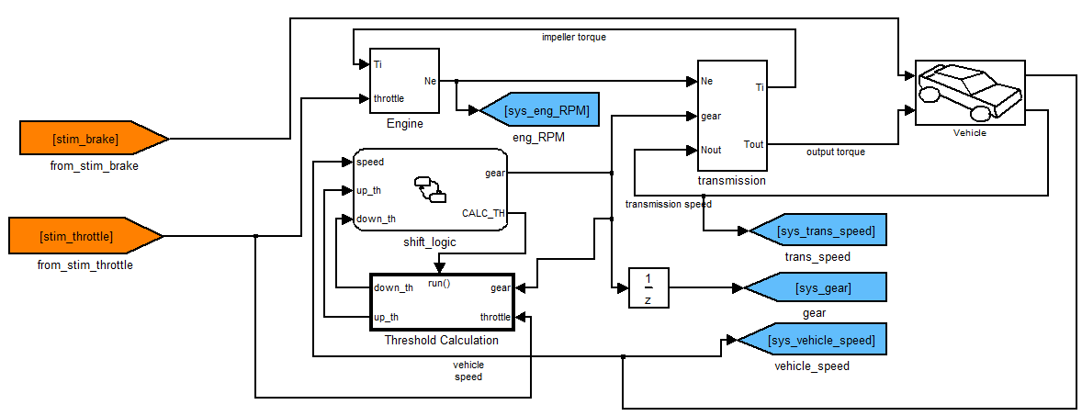
Example: automatic gear system Typical Automotive Application

Slide 7
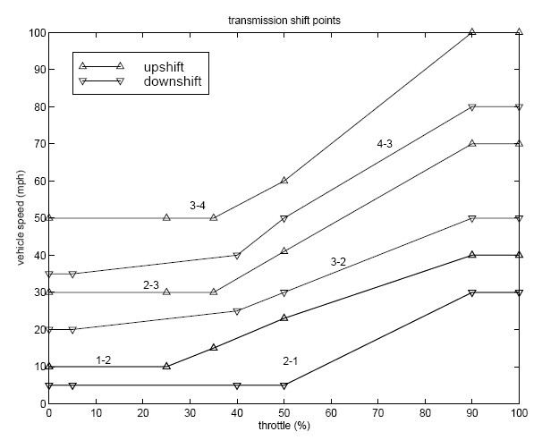
Example: automatic gear system Expected behavior

Slide 8
Example: automatic gear system TTCN-3 embedded test system

Slide 9
Example: automatic gear system The test specification
Direct access to time
testcase limit velocity_gear_3_test() runs on mtcType{
var float s;
// accelerate
Throttle.value := 15.00;
until{
[Gear.value >= 3.0]{Throttle.value := 8.0; s:= Speed.value}
}
// target velocity reached
label constant_drive;
cont {assert(Gear.value == 3.0)}
until{
[now >= 400.0] {} goto final;
[Speed.value <= (s - 8.0)]{
Throttle.value := Throttle.value +1.0;
Brake.value := Brake.value -1.0} goto hold;
[Speed.value >= (s - 5.0)]{
Throttle.value := Throttle.value -1.0;
Brake.value := Brake.value +1.0} goto hold;
}
// regulate velocity
label hold;
cont {assert(Gear.value == 3.0); }
until{[duration >= 10.0 ]{} goto constant_drive;}
// end testcase
label final;
cont {
assert(Gear.value == 3.0);
}
until{
[duration >= 1.0 ]{}
}
}
until{
[Gear.value >= 3.0]{Throttle.value := 8.0; s:= Speed.value}
}
// target velocity reached
label constant_drive;
cont {assert(Gear.value == 3.0)}
until{
[now >= 400.0] {} goto final;
[Speed.value <= (s - 8.0)]{
Throttle.value := Throttle.value +1.0;
Brake.value := Brake.value -1.0} goto hold;
[Speed.value >= (s - 5.0)]{
Throttle.value := Throttle.value -1.0;
Brake.value := Brake.value +1.0} goto hold;
}
Definition of continuous behavior
Access to signals using stream ports
Definition of discrete jumps

Slide 10
Overview On TTCN-3 embedded

Slide 11
TTCN-3 embedded RT Extensions
Access to time at any place in the test
Retrieve the enqueue time of a message,
var float myTime:= now;
// yields the actual time
Gear.receive(t)-> timestamp myTime;
// yields the reception time of a message

Slide 12
TTCN-3 embedded Streams
TTCN-3 streams provide information about values and their timing:
.value provides access to the actual stream value
.timestamp returns the measurement time of a value
.delta provides access to the length of a sampling step
Throttle.value:= 10.0;
Throttle.value:= Brake.value + 10.0;
if (Throttle.timestamp > 10.0) {…}
if (Throttle.delta > 0.001) {…}
Throttle.delta := 0.001;

Slide 13
TTCN-3 embedded Stream navigation
Allow the evaluation of the stream history
.prev(integer index) provides an indexed based access to previous stream values, timestamps and sample times
.at(float timeval) provides a time based access to previous stream values, timestamps and sample times
Throttle.prev.value; // the previous value
Throttle.prev(2).timestamp // the timestamp of the // measurement two samples // ago
Throttle.at(0.0).value; // the initial value
Throttle.at(10.0).timestamp // the timestamp of the // last measurement at // 10.0s or before

Slide 14
TTCN-3 embedded Hybrid behavior specification
seq{
onentry{Brake.value := 0.0}
inv{ Brake.value <= 0.1 }
cont{Throttle.value := 1.0}
until(duration >= 5.0)
cont{Throttle.value := duration + 1.0 * 2.0}
onexit{Throttle.value := 0.0}
} until (duration >= 10.0)
cont{
var integer x :=0; onentry{Brake.value := 0.0}
inv{ Brake.value <= 0.1 }
Throttle.value := duration * 2.0;
assert(EngineSpeed.value < 4000.0);
onexit{Throttle.value := 0.0}
} until (duration >= 10.0)
Modes represent the macro state of the test system
Sampling ensures the repetitive execution of the mode’s content (aka micro state of the test system)
onentry and onexit are executed once, at the beginning or ending of the mode execution
inv, until, assertions and assignments are executed continuously
Parallel and sequential composition is provided by par modes and seq modes that show similar structures.
Cont. Test
Behavior
[g1]
Notes:
Assignments: Sampling of the left side argument
Predicats: Each sampling of streams that are contained in the expressions

Slide 15
TTCN-3 embedded Parametrizable modes
mode myMode(in float x):= seq{
label myModestart;
cont{}inv{ v.value > v.prev.value or
v.value < v.prev.value}
cont{}inv{ v.value == v.prev.value}
until{
[duration > 5.0]{}
[notinv] {} goto start;
}
cont{assert(v.value > x)} until (duration > 5.0)
}
until(duration>60.0)
myMode(10.0);
myMode(40.0);

Slide 16
TTCN-3 embedded Advanced parameterization
timers, templates, and modes allowed as parameters
runs on clause assigns definition to components
type mode MyModeType prototype(in float i)
mode mode2 cont(in float i) runs on MyComp {x:=i};
mode mode1 seq(inout float param1, in float param2,
out float param3,
MyModeType mode2) runs on MyComp{
mode2(10.0);
cont{x:=2;y:=param1;}
until {[duration>param2] {param3=z;}}
}
…
mode1(1.0,2.0,3.0, mode2);

Slide 17
TTCN-3 embedded Predefined functions
Mathematical functions
sqrt, root, pow, loge, log10, logx, exp
sin, cosin, tan, asin, acosin, atan,
max, min , abs , floor, ceiling, round, sign, sizeof
pi, euler
Signal generation functions
Signal comparison functions

Slide 18
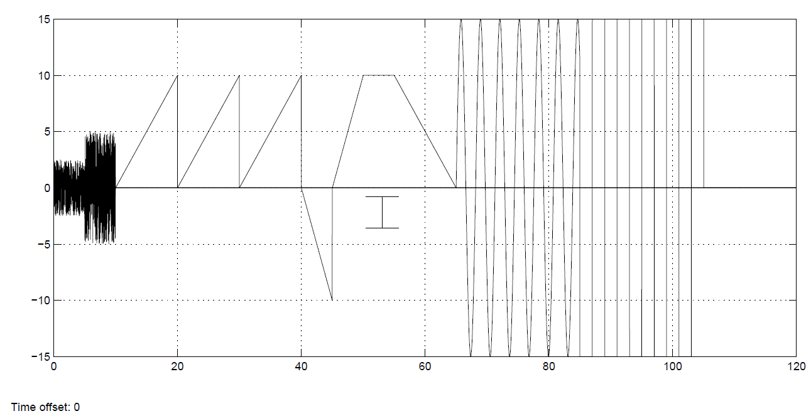
TTCN-3 embedded Signal generation
testcase signal_generation() runs on mtcType{
seq{
apply_noise(Throttle, 5.0, 5.0);
apply_noise(Throttle, 10.0, 5.0);
apply_ramp(Throttle, 10.0, 10.0, 2.0, 3);
apply_ramp(Throttle, -10.0, 5.0, 2.0, 1);
apply_trapezoid(Throttle, 10.0, 0.0, 5.0, 5.0, 10.0,1);
apply_sinewave(Throttle, 15.0, 0.5, 20.0);
apply_squarewave(Throttle, 15.0, 0.5, 20.0); }}

Slide 19
TTCN-3 embedded Signal comparison
absolute difference
m-relative difference
m-slope difference
function AbsDifference(in SignalType signal,
in SignalType ref,
in float timeval)
return float
// return abs(signal.at(timeval).value - ref.at(timeval).value);
function MRelDifference(in SignalType signal,
in SignalType ref,
in float timeval)
return float
// return absDifference(signal,ref,timeval) // /(sqrt(abs(signal.at(timeval).value)) // * sqrt(abs(ref.at(timeval).value)));
function MSlopeDifference(in SignalType signal,
in SignalType ref,
in float timeval)
return float
// var float _sd:= signal.at(timeval).delta;
// var float _s:= sqrt(abs(1.0/2.0*_sd // *(signal.at(timeval-_sd).value // -signal.at(timeval).value)));
// var float _rd:= ref.at(timeval).delta; // var float _s:= sqrt(abs(1.0/2.0*_rd // *(ref.at(timeval-_rd).value -ref.at(timeval).value))); // return absDifference(signal.at(timeval-_sd).value, // ref.at(timeval-_rd).value)/(_s * _r);

Slide 20
TTCN-3 embedded Assessment and offline analysis
type record Sample { float value_, float timestamp_, float delta_};
type Samples record of Sample;
testcase myTestcase () runs on Tester{
var Samples sRec;
// measure on all incoming ports for 100 seconds
wait(100.0);
// get the all sampless at myInport until now
sRec:= EngineSpeed.history(0.0, now);
var int i;
for(i:=0;i<lengthof(myStreamRec); i:=i+1){
assert(sRec[i].value_ >= 10.0);
}
}

Slide 21
TTCN-3 embedded Assessment and offline analysis
template Samples Greater10:= { +(Sample:{value_:=(10.0 .. infinity),
timestamp_:=?, delta_:=?)} };
assert(match (sRec, Greater10));
template Samples SequenceOfGreaterOne := { #(5,40)(Sample:{value_:=(5000.0 .. infinity),
timestamp_:=?, delta_:=?)} };
find (sRec, AllGreaterThanTenOrNone);
count (sRec, AllGreaterThanTenOrNone);

Slide 22
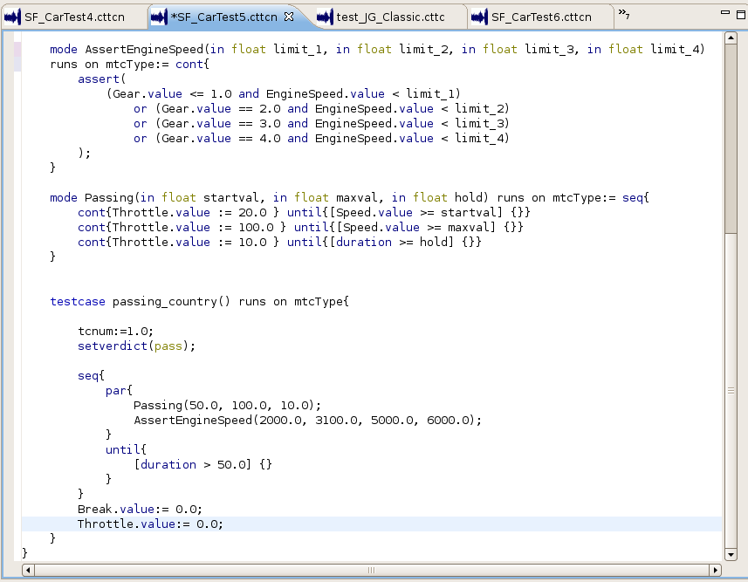
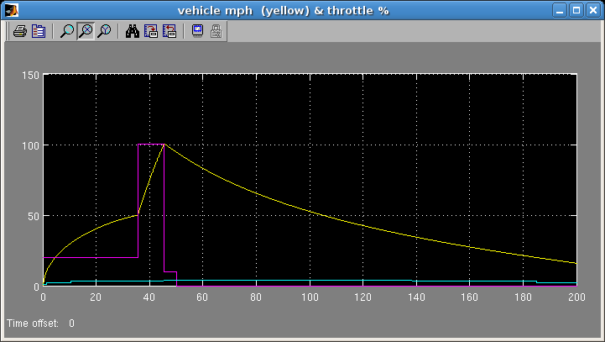
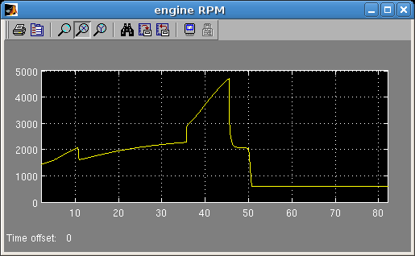
Integration with Matlab/Simulink

Slide 23
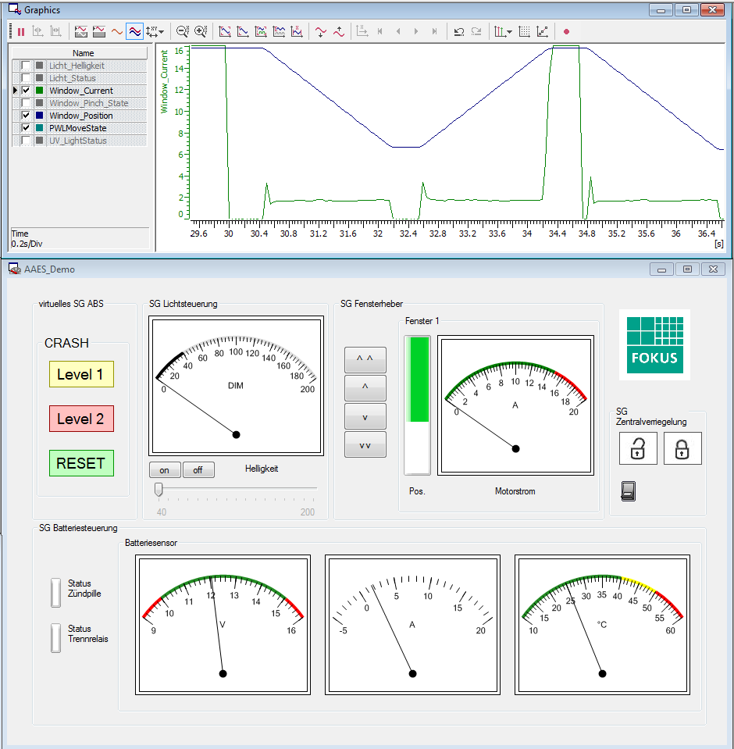
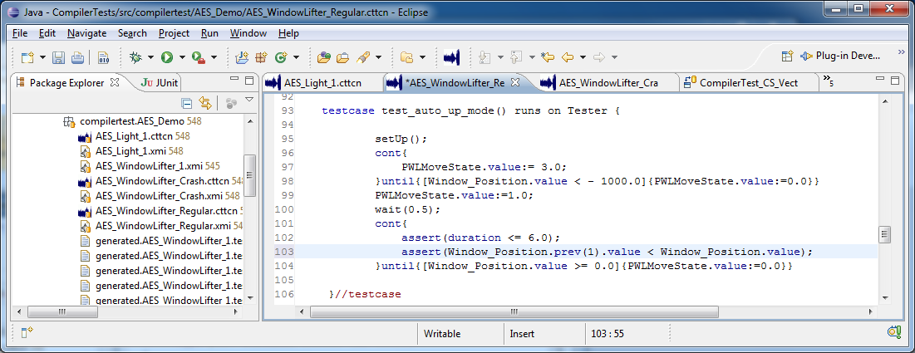
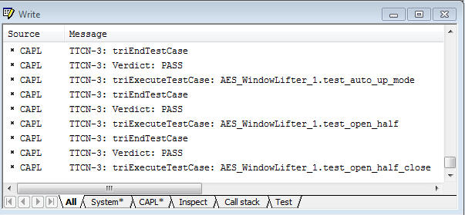
Integration with CANOE

Slide 24
TTCN-3 embedded Summary and outlook
TTCN-3 embedded concepts are defined
RT are available with TTCN-3 V 4.2.1
Continuous concepts are in preparation for standardization
Explorative compiler are available
FOKUS TTCN-3 embedded compiler and runtime
Testing Technologies TT-Workbench with TTCN-3 embedded support
Research on test reuse for component based systems

Slide 25
Contact and information
www.temea.org
Jürgen Großmann
Fraunhofer FOKUS
Kaiserin-Augusta-Allee 31,10589 Berlin
Tel: +49-30-3463-7390
juergen.grossmann@fokus.fraunhofer.de
Notes:
Kurzprofil Fraunhofer Institut FOKUS
Die gestiegen Herausforderungen im Automotive Software Engineering sind die Treiber für die Forschungs- und Entwicklungsarbeiten am Fraunhofer Institut FOKUS.
Automotive Software schafft innovative Sicherheitssysteme, befindet sich jedoch im Spannungsfeld von Kostenreduktion und Qualitätssteigerung

