Slide 1


MiL Testing using TTCN-3:
Concepts and Case Study
TTCN-3 User Conference 2011 7 – 9 June 2011 - Bled, Slovenia
Marcus Mews, Technical University of Berlin *
mews@cs.tu-berlin.de
Jaroslav Svacina, Fraunhofer FIRST **
jaroslav.svacina@first.fraunhofer.de
* This work is carried out as part of the VirtuOS project. The VirtuOS project is financed by TSB Technologiestiftung
Berlin – Zukunftsfonds Berlin and co-financed by the European Union – European fund for regional development.
** This work is carried out as part of the MODELISAR project (ITEA 2).

Slide 2
Outline
Motivation
Requirements for testing MiL setups with standard TTCN-3
TTCN-3 concepts for MiL testing
Test system architecture
Screen cast
Summary & Conclusion
Marcus Mews, Jaroslav Svacina: MiL Testing using TTCN-3: Concepts and Case Study

Slide 3
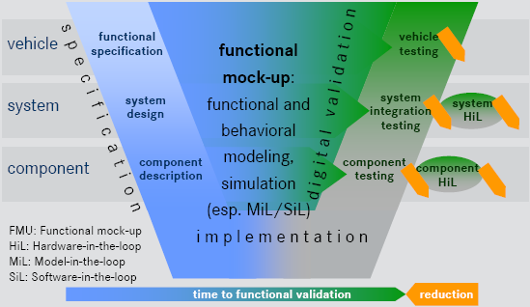
Early Testing using Model in the Loop simulation
Goal:
Reduce development costs
Early integration of components
  Components of different domains/tools
  Auxiliary components (environment, …)
Early testing during development using TTCN-3 FX (FhG FIRST)
Problems:
Technical coupling: Different tools, interfaces, data types, communication patterns
Heterogeneous test infrastructure → TTCN-3
Test case specification: Handling simulation data and time
Marcus Mews, Jaroslav Svacina: MiL Testing using TTCN-3: Concepts and Case Study
Notes:
Detailsimulation eingebettet in Gesamtsystem-Analyse
Für jedes Subsystem den am besten geeignete Simulator wählen!
Je später ein Fehler auftritt, desto kostenintensiver ist seine Behebung
-> Frühzeitige Integration, um
Zusammenwirkung verschiedener physikalischer Domänen und Steuerungssoftware
Gemeinsame, integrierte Betrachtung verschiedenen Subsysteme
Aber: Verschiedene Modellierungs- und Simulationswerkzeuge etabliert
Mechanik, Hydraulik, Elektronik, Software, …
Wenige proprietäre Co-Simulationsansätze verfügbar
---------------------------------------------
Verschiedene Modellierungs- und Simulationswerkzeuge etabliert
Mechanik, Hydraulik, Elektronik, Software, …
Wenige proprietäre Co-Simulationsansätze verfügbar
Großer Bedarf an „Virtual Prototyping“ Ansätzen in der Industrie
Ermöglicht frühzeitiges, schnelleres und kosteneffizienteres Testen der Fahrzeugfunktionalität in einer virtuellen Umgebung
Fördert domänenübergreifende Kollaboration und Innovation
Domänen- und werkzeugübergreifende virtuelle Integration
Zusammenwirkung verschiedener physikalischer Domänen und Steuerungssoftware
Gemeinsame, integrierte Betrachtung verschiedenen Subsysteme

Slide 4
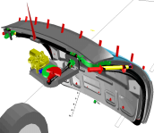


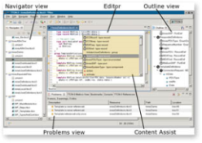



MiL Scenario: Power Liftgate co-simulation
Liftgate Multi Body model
E-Motor model
Controller model
Simpack
Dymola
Matlab/Sim./TargetLink
TTCN-3 Test Suite
Liftgate-dll
E-Motor-dll
Controller-dll
TTCN-3-dll
Silver Cosimulator
TTCN-3 FX
Silver
Marcus Mews, Jaroslav Svacina: MiL Testing using TTCN-3: Concepts and Case Study

Slide 5
Requirements for testing MiL setups with standard TTCN-3
Test Case interferes with a running MiL system
TTCN-3 covers all requirements for testing discrete system
Testing MiL systems requires additional concepts for:
  Signals / data streams / continuous variables
  Sample independent signal handling
  Read signals (current, history values)
  Write signals (constants, value series)
  Observe signals (specify and trigger events)
  Access to simulation time
  Synchronization with MiL simulation
  Embedding into a closed loop system
Marcus Mews, Jaroslav Svacina: MiL Testing using TTCN-3: Concepts and Case Study

Slide 6
TTCN-3 Concepts for MiL Testing
Added special TTCN-3 ports for simulation:
  Synchronize port (Procedure Port)
  Signal ports (Procedure Port)
  Event ports (Mixed Port)
MiL specific semantics
Implemented in TTCN-3 adapter
Marcus Mews, Jaroslav Svacina: MiL Testing using TTCN-3: Concepts and Case Study

Slide 7
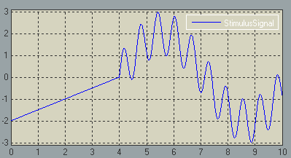
TTCN-3 Concepts for MiL Testing (2)
// Read Data
DataPort1.call(GetValue:{})
{
[] DataPort1.getreply( GetValue:{} )
-> value result {}
}
DataPort1.call( History:{0.0, 5.0} )
{
[] DataPort1.getreply( History:{0.0, 5.0} )
-> value sampledSignal {}
}
// Write Data
DataPort1.call(SetValue:{ 1.0 });
DataPort1.call(SetSignal:{StimulusSignal});
Signal Ports:
  Read current values
  Read history values
  Set values
  Set signals
  → Declarative signal description (ASAM AE HiL)
template Signal StimulusSignal := {ramp1, add1}
template SignalSegment ramp1 := {
rampSegment := {
  Duration := 4.0,
  Start := -2.0,
  Stop := 0.0
}
}
// ... Add1 = sine1(t) + sine2(10t)
Marcus Mews, Jaroslav Svacina: MiL Testing using TTCN-3: Concepts and Case Study

Slide 8
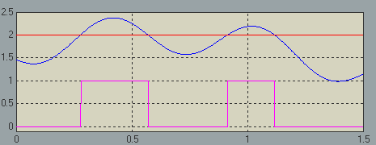
TTCN-3 Concepts for MiL Testing (3)
Trigger_t1.call(SetTrigger:{"DataPort1 > 2"});
Trigger_t1.call(Activate:{});
// Trigger_t2 ...
timer maxRiseTime;
maxRiseTime.start (10.0);
var TimeStamp timeStamp;
alt {
[] Trigger_t1.receive(anyTimeStamp)
-> value timeStamp {
maxRiseTime.stop;
setverdict(pass);
}
[] Trigger_t2.receive(anyTimeStamp)
-> value timeStamp {
maxRiseTime.stop;
setverdict(pass);
}
[] maxRiseTime.timeout {
setverdict(fail);
}
}
Trigger_t1.call(Deactivate:{});
Event Ports:
  Set trigger
  → ASAM AE Gen. Expr. Syntax
  Activate trigger
  Deactivate trigger
  Receive events
Marcus Mews, Jaroslav Svacina: MiL Testing using TTCN-3: Concepts and Case Study

Slide 9
Synchronization of TTCN-3 Test Case and MiL (1)
Synchronization:
  Single thread TTCN-3 test case
  Variable/fixed step solver
  Adapter located in test execution environment
Interaction:
  a Next simulation step values
  b Timeout, trigger event, yield
  Read/set values, …
  c Wait, yield, receive event
  d Modify simulation values
  Solving model equations
TTCN-3 Test Case
Adapter
MiL
b
a
t0
c
d
a
t1
d
b
a
c
d
t
Marcus Mews, Jaroslav Svacina: MiL Testing using TTCN-3: Concepts and Case Study

Slide 10
Synchronization of TTCN-3 Test Case and MiL (2)
a Simulation Step Calculated:
  MiL Solver finished one step (variable/fixed)
  Software/hardware sample
b Test Case Resume:
  Trigger event (event detected)
  Timeout (rel. time) (time point reached)
  Abs. time point (→ trigger event)
  Yield (always)
c Test Case Pause:
  Wait for event (event Port)
  Wait for rel. time (timer)
  Wait for abs. time (→ wait for event)
  Yield (synchronize Port)
TTCN-3 Test Case
Adapter
MiL
b
a
t0
c
d
a
t1
d
b
a
c
d
t
Marcus Mews, Jaroslav Svacina: MiL Testing using TTCN-3: Concepts and Case Study

Slide 11

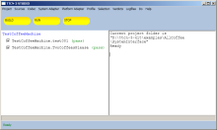
Case Study Tool Architecture
TTCN-3 Test specification
in Eclipse + TRex
  Several participating tools (Process)
  TTCN-3 adapters implement interface, synchronization, triggers, ...
  FMI developed in context of MODELISAR
TTCN-3 FX
Test Management
TTCN-3 FX Compiler
Silver Comp 1
Test Execution Environment
Control (Start/ Stop)
Co-Simulation Controller
Codec
TTCN-3 Test Executable
Silver
TTCN-3 Proxy
Stimulate/Drive Simulation, Observe
Assessment Component
System Adapter
Synchronize Time
Silver Comp N
Signal Generator
Platform Adapter
TTCN-3 FX Runtime Environment
MiL Specific Components
Co-Simulation Interface (FMI)
TTCN-3 Runtime Interface
TTCN-3 Control Interface
Marcus Mews, Jaroslav Svacina: MiL Testing using TTCN-3: Concepts and Case Study

Slide 12
Case Study: Example Test Case
type component PowerLiftGateTestComponent {
port DataPortType Klappenwinkel_deg; // ...
port TriggerPortType Trigger_Posedge;
}
testcase OpenClose() runs on PowerLiftGateTestComponent system PowerLiftGateTestComponent {
Trigger_Posedge.call(SetTrigger:{"posedge (Klappenwinkel_deg, 80.0)"});
Trigger_Negedge.call(SetTrigger:{"negedge (Klappenwinkel_deg, 80.0)"});
Trigger_Posedge.call(Activate:{}); Trigger_Negedge.call(Activate:{});
// ...
timer maxPowerLiftGateOpenTime; timer requiredThresholdTime;
maxPowerLiftGateOpenTime.start (10.0);
alt {
[] Trigger_Posedge.receive(anyTimeStamp) {
requiredThresholdTime.start (1.0);
repeat;
}
[] Trigger_Negedge.receive(anyTimeStamp) {
  requiredThresholdTime.stop;
  repeat;
}
[] requiredThresholdTime.timeout {
maxPowerLiftGateOpenTime.stop;
setverdict(pass);
}
[] maxPowerLiftGateOpenTime.timeout {
setverdict(fail);
} } }
Marcus Mews, Jaroslav Svacina: MiL Testing using TTCN-3: Concepts and Case Study

Slide 13


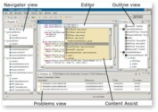

Case Study Setup
Setup:
  TTCN-3 FX controls co-simulation
  Integration platform (Silver)
  Behavior models as dlls
  TRex TTCN-3 editor
Liftgate Multi Body model
E-Motor model
Controller model
Simpack
Dymola
Matlab/Sim./TargetLink
TTCN-3 Test Suite
Liftgate-dll
E-Motor-dll
Controller-dll
TTCN-3-dll
Silver Cosimulator
TTCN-3 FX
Silver
Marcus Mews, Jaroslav Svacina: MiL Testing using TTCN-3: Concepts and Case Study

Slide 14
Summary & Conclusion
  Model access
    Sampling independent read, write (modify) signals from MiL
    Access to simulation time
    Event driven test case (events: time, triggers on signals, solver step)
    Assessment (online / offline, trigger based / manually)
  Simulation control
    Configuration, initialization, synchronization
    Start, stop, restart, reinit
  Lesson learned
    Testing MiL setups with standard TTCN-3 possible
    Additions to TTCN-3 desirable:
      Language: absolute time, time independent signals, triggers on signals
      TRI: TTCN-3 test case is idle
Marcus Mews, Jaroslav Svacina: MiL Testing using TTCN-3: Concepts and Case Study

